Slide 1
Battle of Neighborhood
-Harika Penjerla

Slide 2

Business Problem
To predict the recommend hot spot to start a Coffee Shop.
Location: Cleveland, Ohio.

Slide 3

Data Collection
Fetching data using Foursquare API

Slide 4
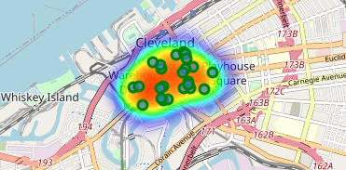
Visualization
Used Folium library
Visualized the Cleveland, Ohio map with 24 limited coffee shops

Slide 5
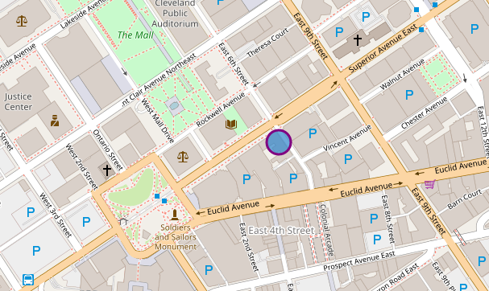
Results
We can notice here the east 6th street and superior avenue is the recommended best hot spot to start coffee shop.

Slide 6
Future Scope/References
Furthermore in future I may plan to extend this project using data about Cleveland neighborhood and foursquare API data to predict more insights and perform clustering also.
https://labs.cognitiveclass.ai/tools/jupyterlab/lab/tree/labs/DP0701EN/DP0701EN-3-3-2-Neighborhoods-New-York-py-v1.0.ipynb
https://stackoverflow.com/questions/48085110/no-module-named-folium-plugins-python-3-6
https://medium.com/@aboutiana/a-brief-guide-to-using-foursquare-api-with-a-hands-on-example-on-python-6fc4d5451203
https://developer.foursquare.com/
https://towardsdatascience.com/data-101s-spatial-visualizations-and-analysis-in-python-with-folium-39730da2adf
https://dev.to/chijade/capstone-project-the-battle-of-neighborhoods-4ha3

